Slide 1
Smart Community Kitchens
An IOT based solution for Community Kitchens

Slide 2
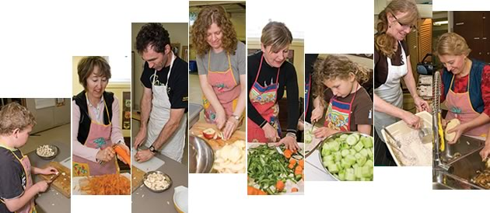
What are Community Kitchens?
Community Kitchen is a public space where groups of people cook on a regular basis offering the opportunity for participants to share skills, socialize and reduce meal costs by cooking collectively.
People volunteer to cook, wash dishes, serve food and manage groceries themselves.

Slide 3
What IOT can do here?
There is no single person managing all the things to run a community kitchen so nobody has exact information about events, menu, and supplies in real time.
Single person manages all the groceries and supplies and when he is unavailable it is hard for somebody else to step into his shoe.
Suppliers of the kitchen service do not have any information about things that are low on stock.
To address these problems an IOT based Containers that monitor supplies, groceries and give real time information about quantity, quality of the food stored in them.
They can also record expiry date of the food and an can alert administrators about most likely issues.

Slide 4
What this project aims at?
Smartly connected community kitchen App is a platform where all the kitchen participants can easily communicate and they can have real-time data of all the grocery supplies, events and menu.
They can now plan their activities clearly and better manage the whole functioning of the system.
The administrator does not have to be a single person and more distributed responsibility structure is maintained.
Volunteers/Administrators schedule their volunteering slots according to their preferences and availability.
Suppliers monitor the data shown by grocery containers (IOT devices) and can supply items that are low on stock.

Slide 5

Implementations
IOT devices (Containers) are simulated by a web server where they
dump real time grocery quantities.
Suppliers, Coordinators or chefs query for the latest quantities of
Grocery items and then can plan their actions.
All the participants are divided in following organizations
Administrators
Chefs
Volunteers
Suppliers
A dashboard for participants where they shall have all the information they need.

Slide 6
Features
Oauth 2.0 based secured Email Connectivity for Gmail Users
FTP Web server where combined data of all the groceries are stored.
Event Scheduling
Job Scheduling (Both push and pull model works simultaneously)
Keeps record of task completed and tasks to be performed.
Menu for each event and dish records are maintained by application.
Credentials are emailed to new volunteers so that false identities are prevented.
Only One time authentication is needed for all users to stay connected on the device.
No need of changing setting into gmail account “Allowed for less secure apps”.

Slide 7
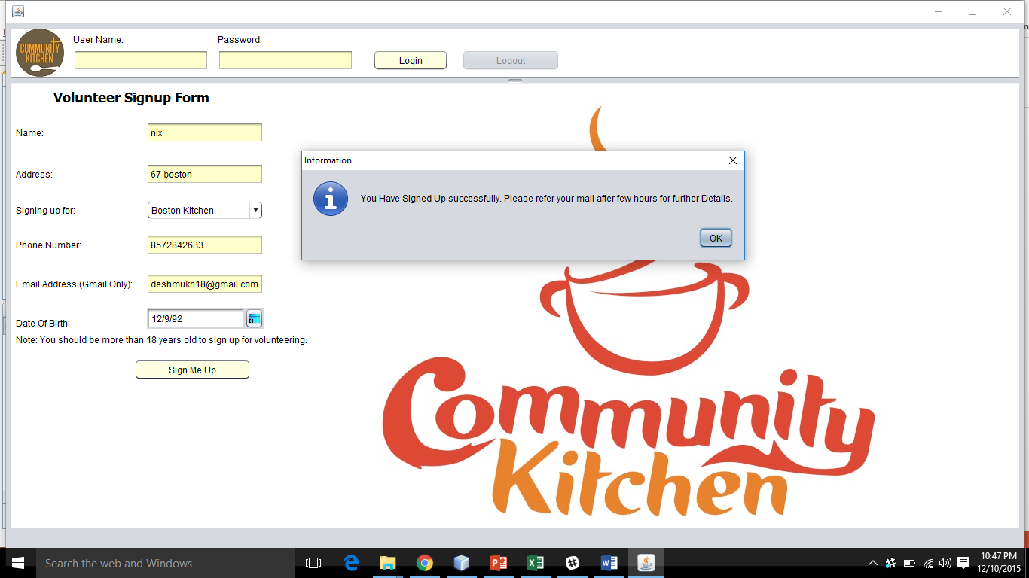
Volunteers Sign Up

Slide 8
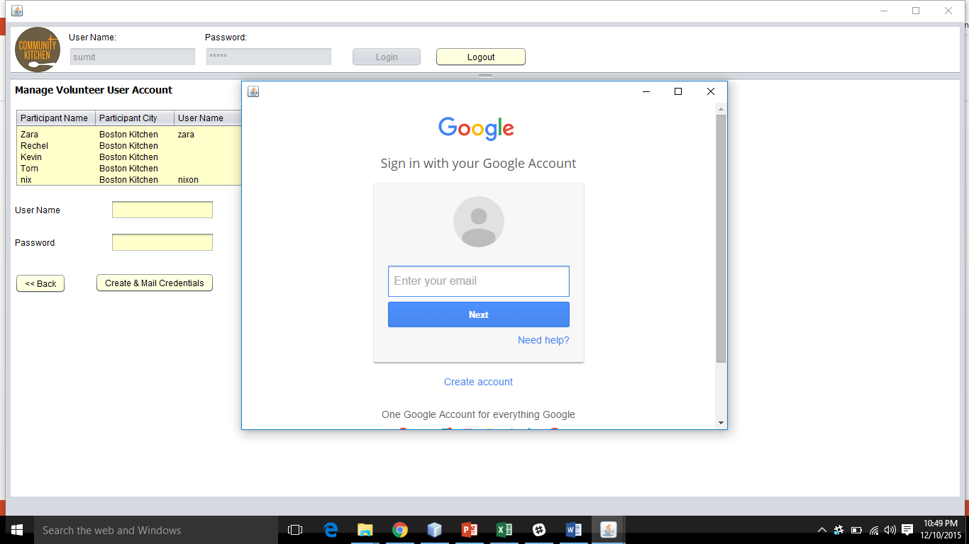
Credentials are Emailed

Slide 9
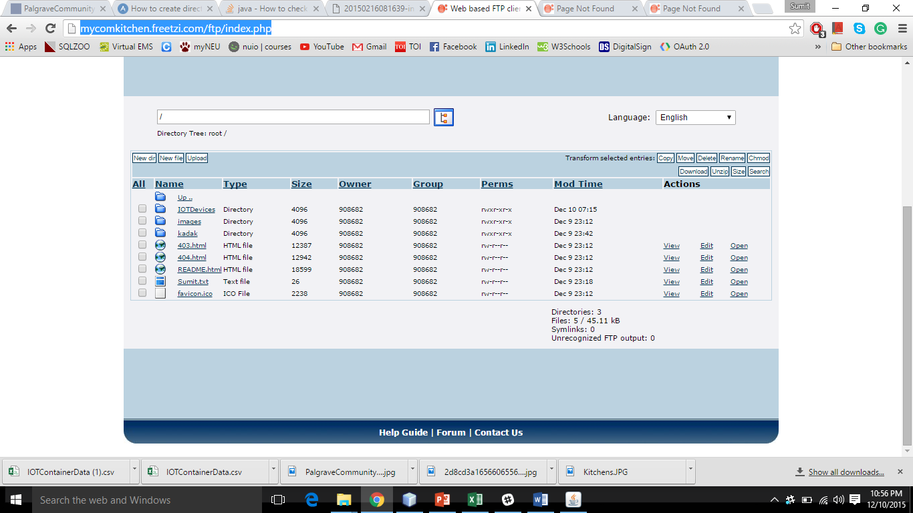
FTP Web Server

Slide 10
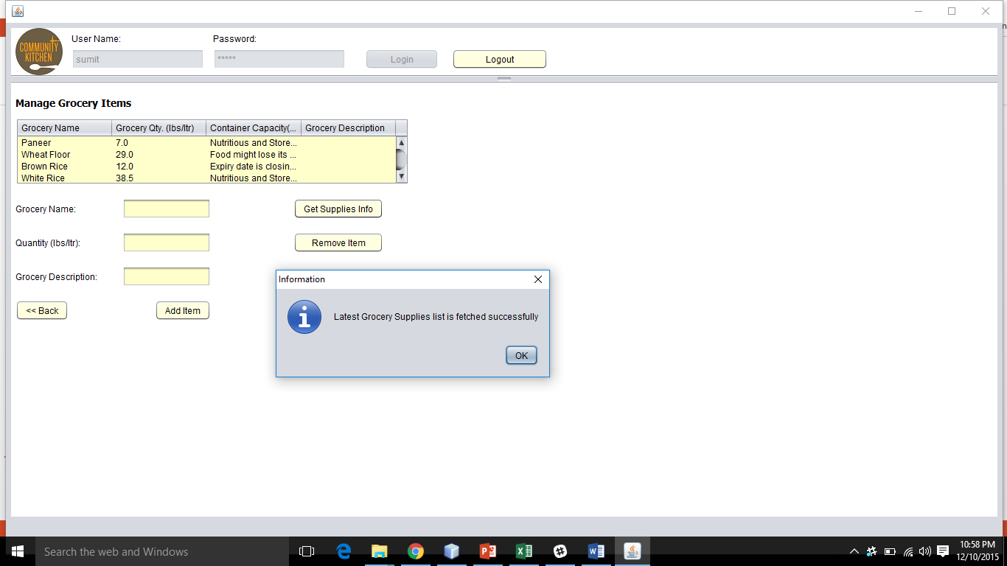
Grocery List is fetched from Web server

Slide 11
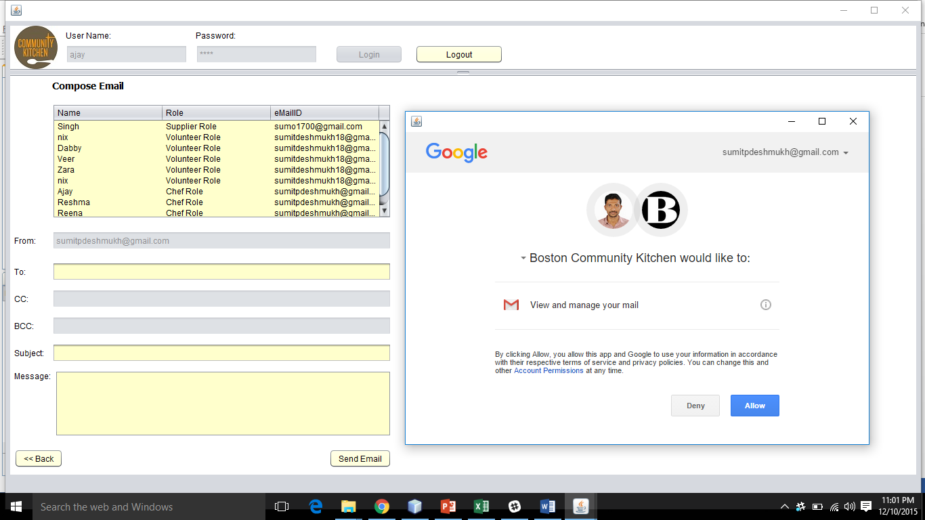
Compose Email and Autentication

Slide 12
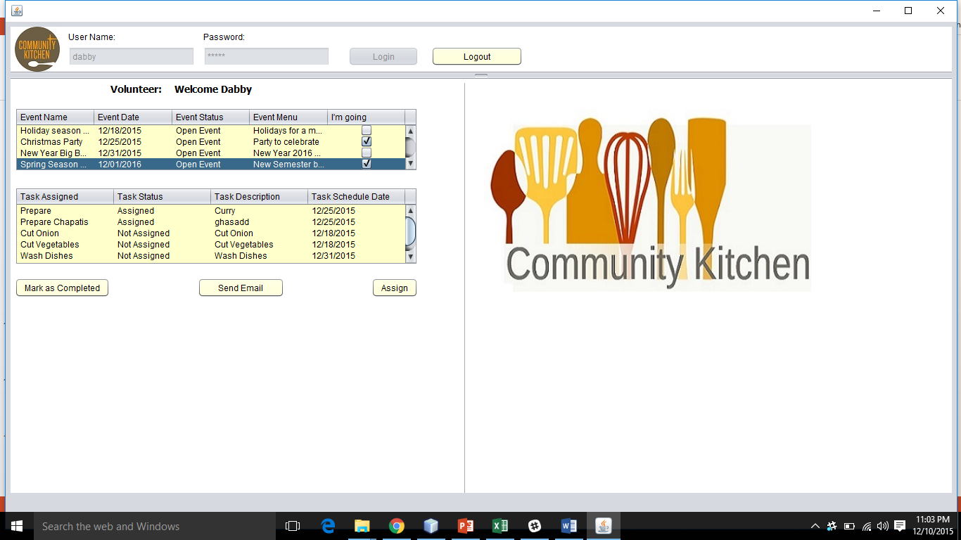
Volunteer Dashboard

Slide 13
Thank You.

